Slide 1
The Department of Oral Pathology, The Oxford Dental College organized an activity on WORLD CANCER DAY with the theme of ‘’Close the Care Gap’’
An e-poster competition on ORAL CANCER-SELF EXAMINATION was conducted for 3rd BDS undergraduate students.

Slide 3
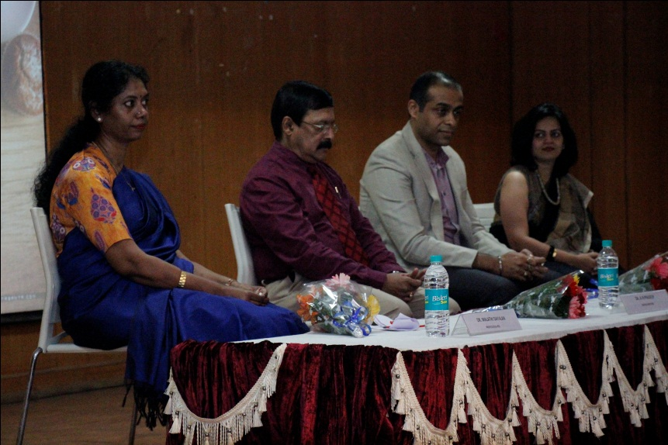
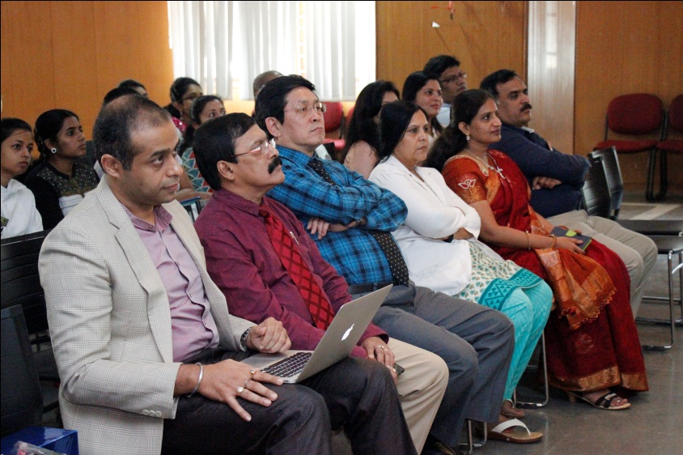
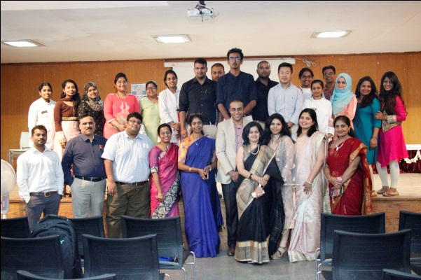
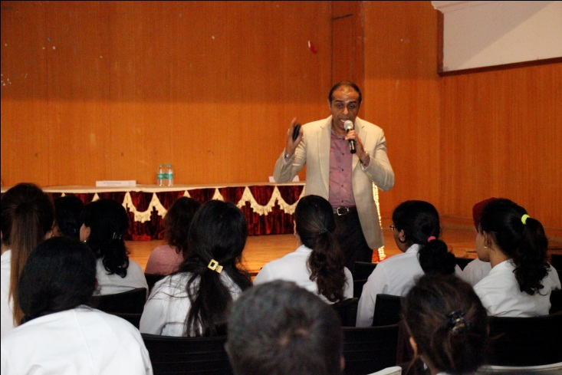
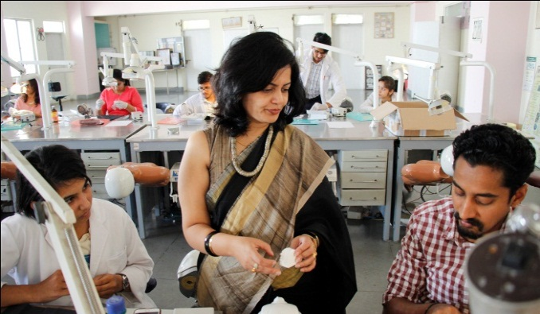
The Department of Prosthodontics conducted a CDE program on “ESTHETICS- Discovery en route to newer technology” Esthetic hands-on on Veneers on 5th December, 2018 by Dr Rohit Shetty

Slide 4
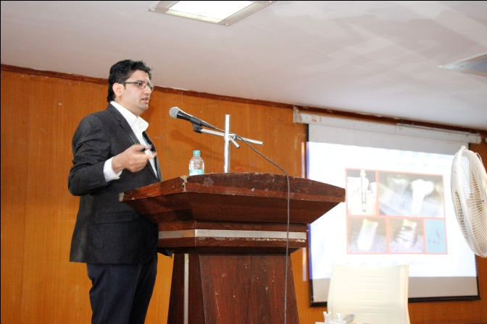
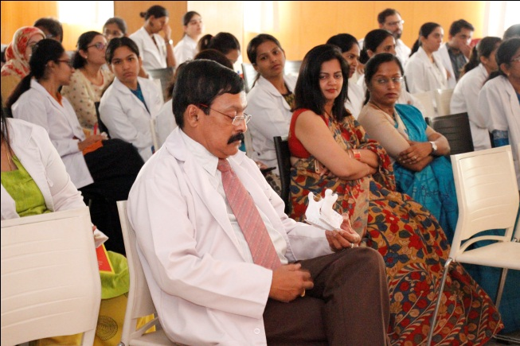
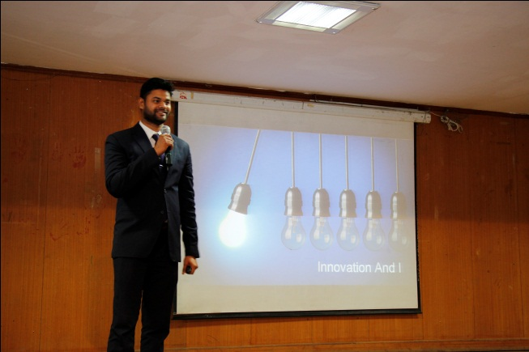
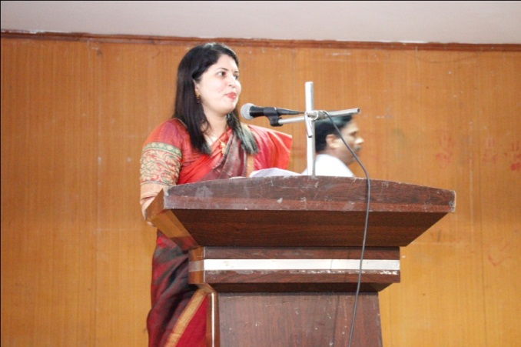
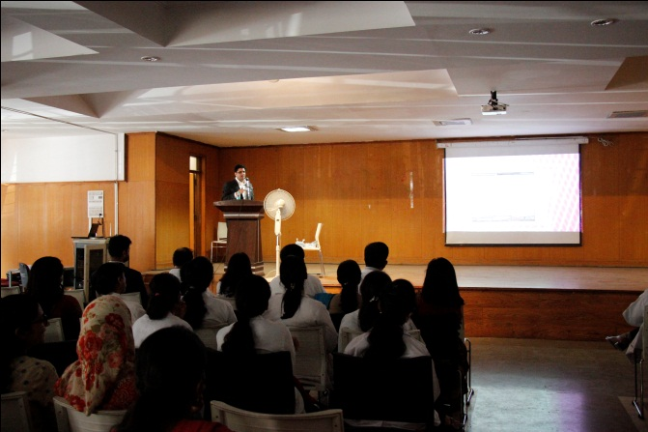
The Department of Prosthodontics conducted a symposium on steps of innovations in dentistry on 23rd may 2018.
Title: V-Invent Dentistry
Presenters:
Dr. Abhishek Nagaraj MDS (Prosthodontics) FIPM (Kidwai)
Dr Akash Chakravarthy MDS (OMFS)

Slide 5
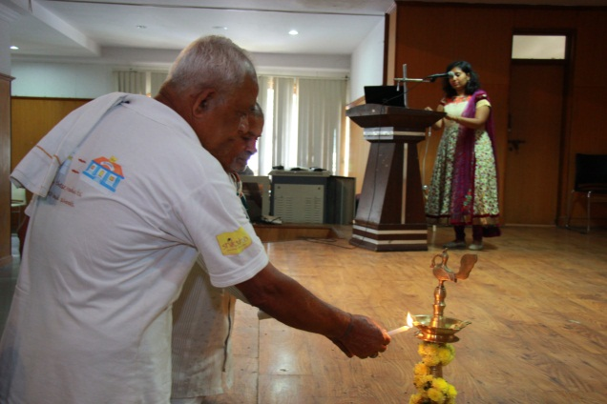
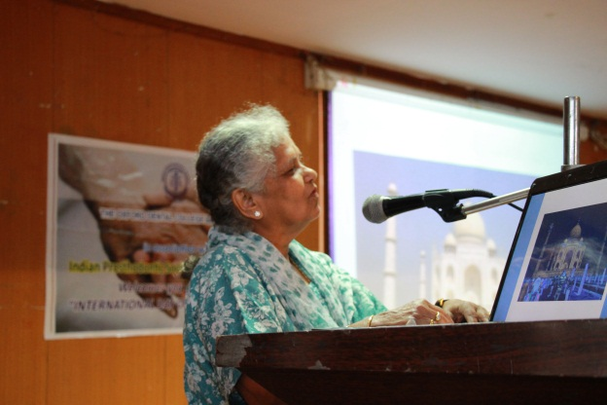
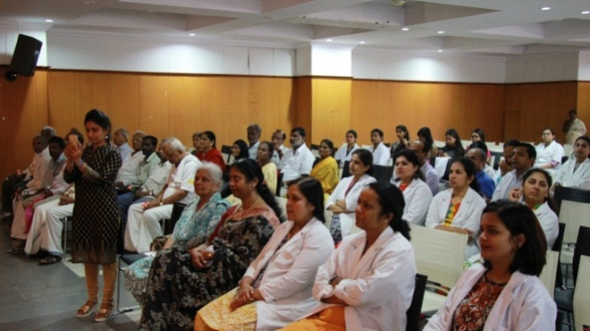
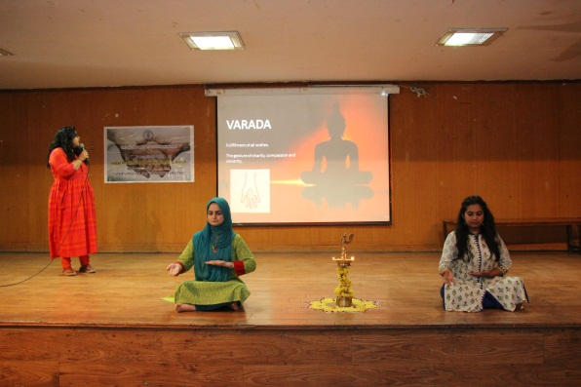
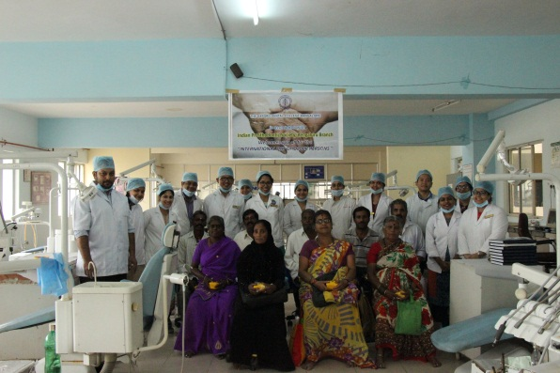
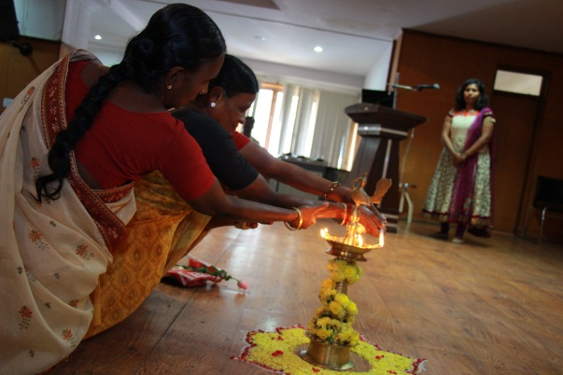
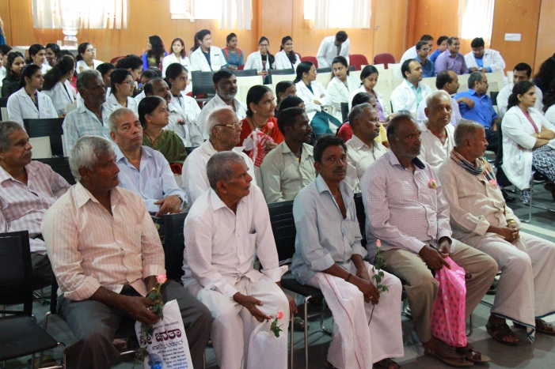
World Elder’s Day was celebrated in the Department of Prosthodontics in October 2017. A cultural program was arranged for the elderly patients, followed by lunch. The day concluded with patient education, free denture camp and complimentary denture boxes were give to all the patients

Slide 6
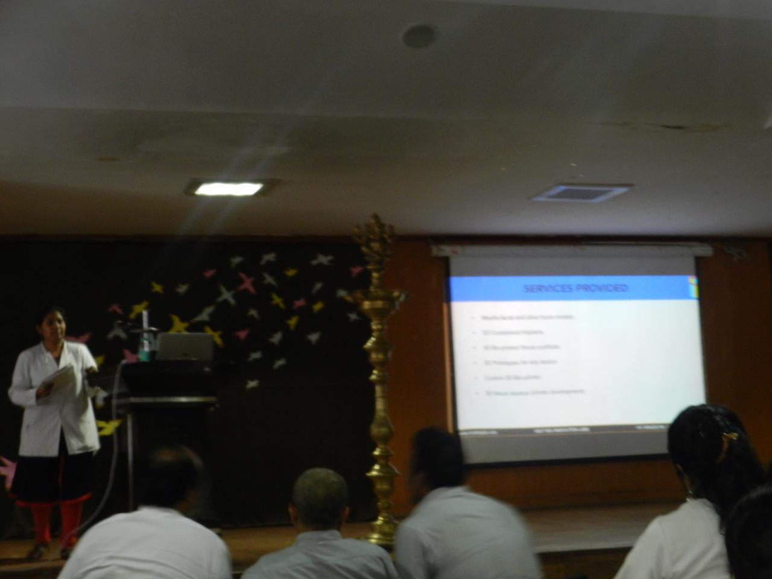
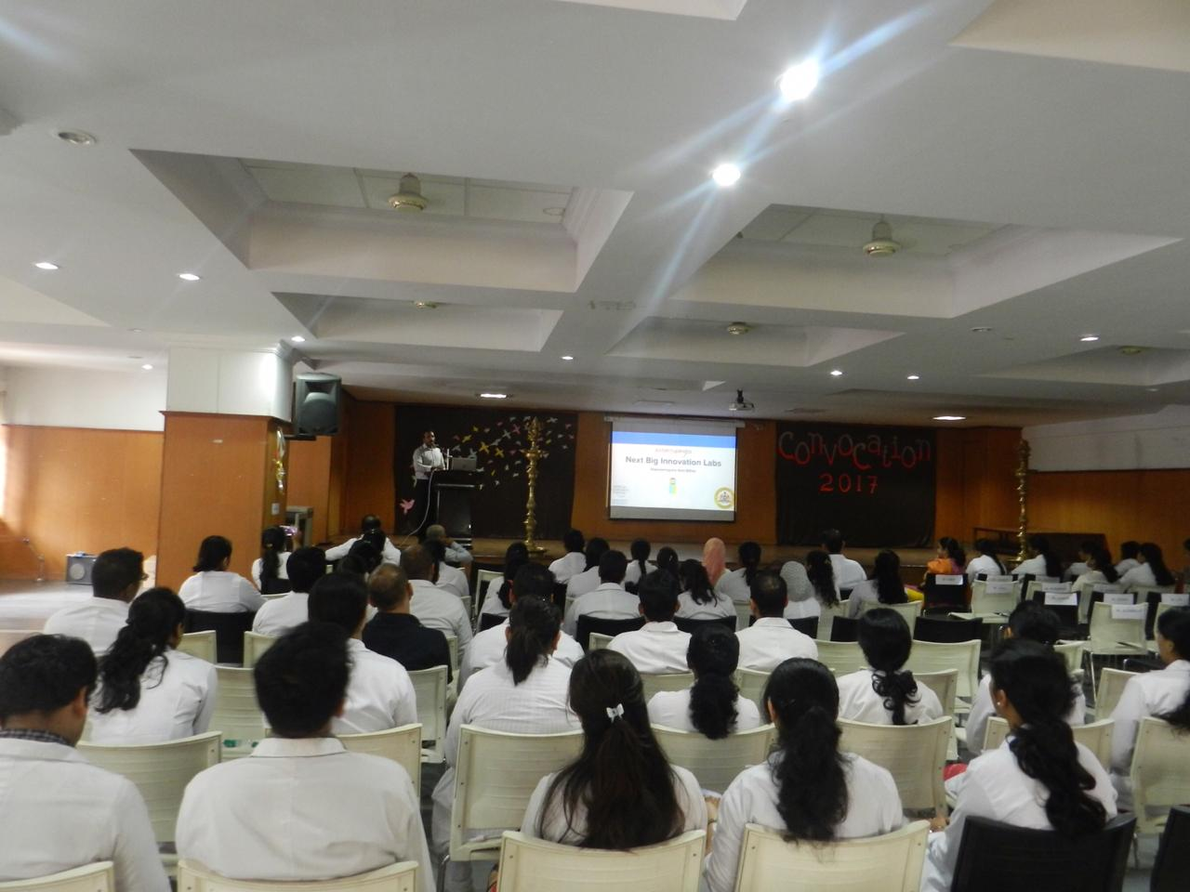
A CDE program on “3D printing in dental and maxillofacial prosthesis” was conducted by
Dr S. V. M. Thirumurugan on 13th September 2017

Slide 7
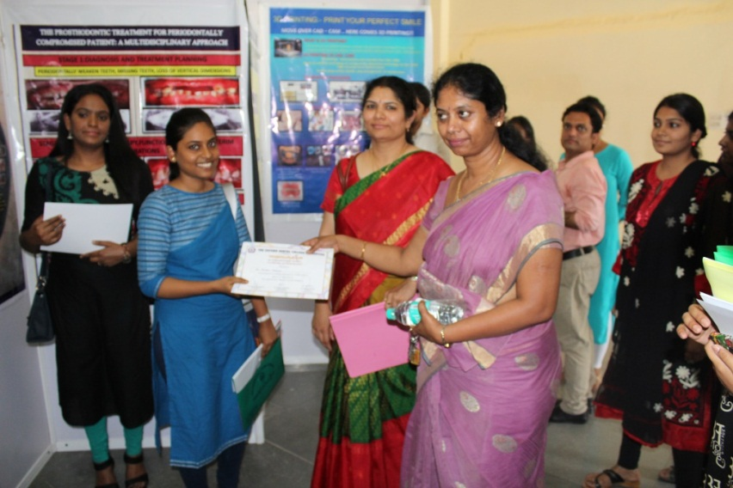
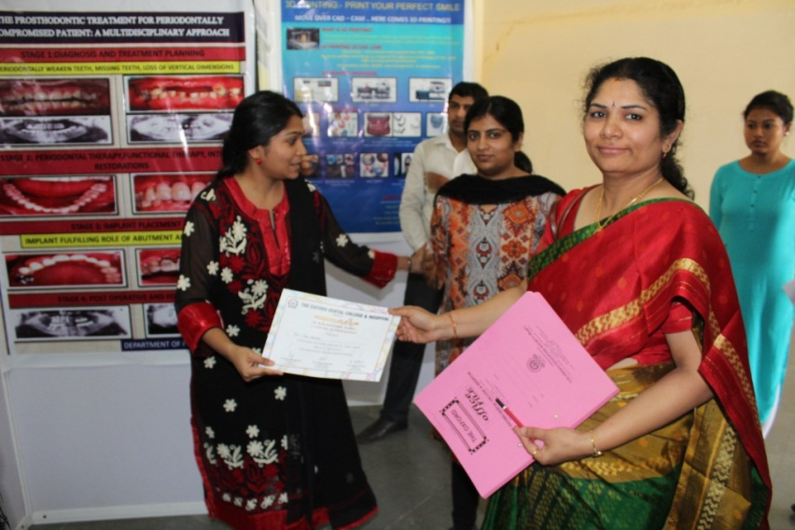
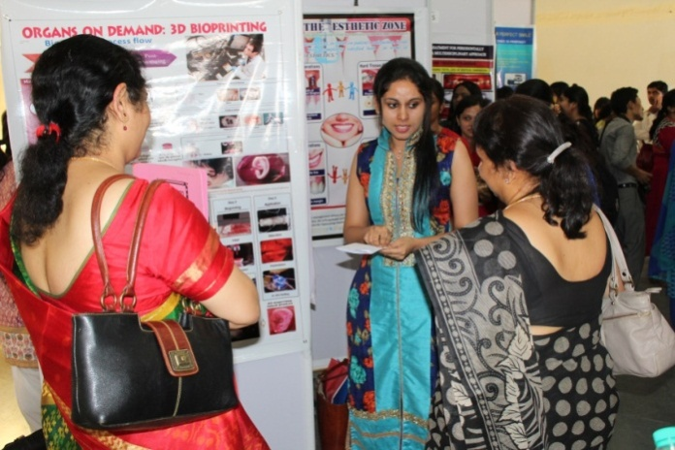
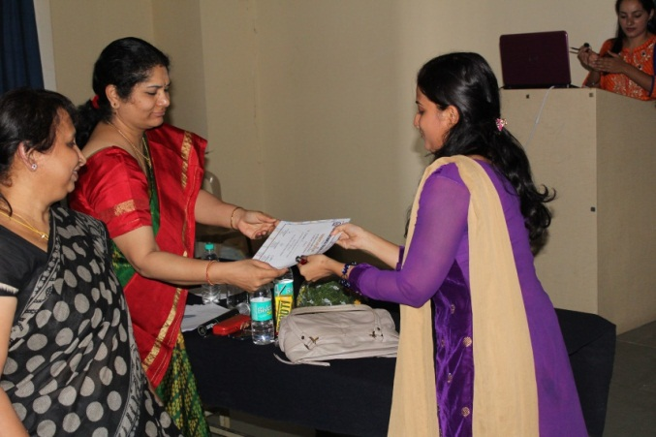
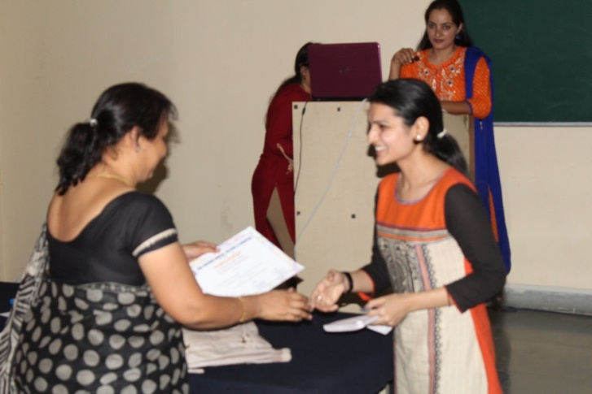
An intercollege program “Odontoplexus” was conducted for post graduates in the month of April 2016

Slide 8
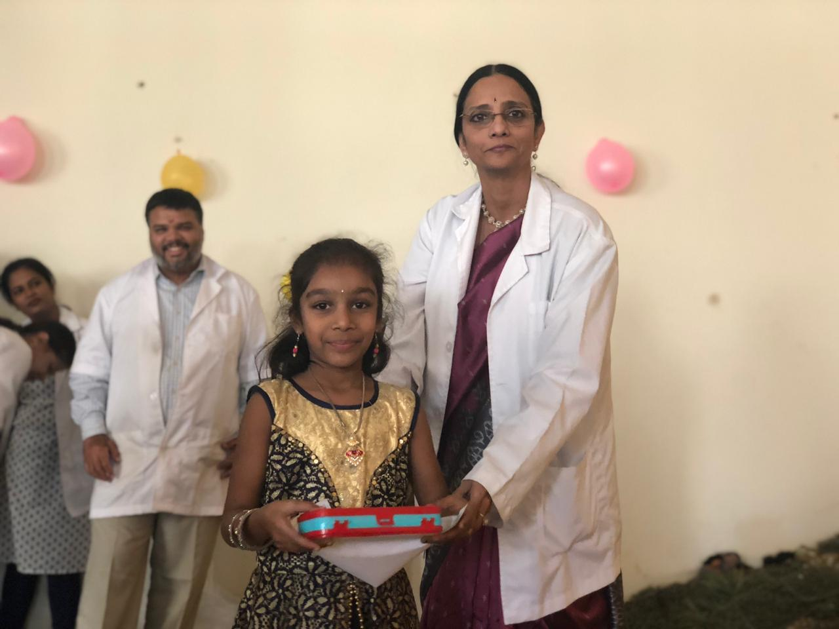
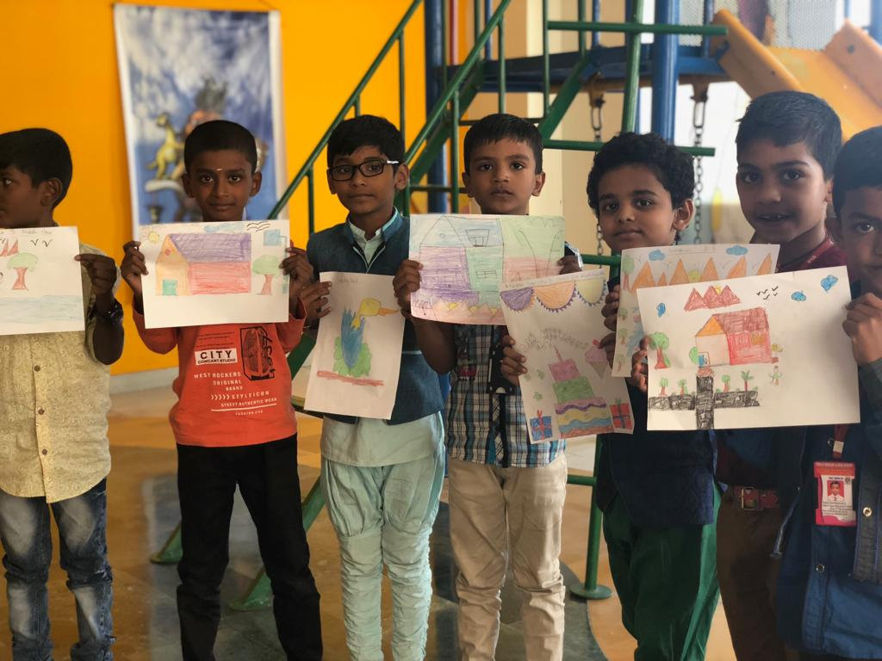
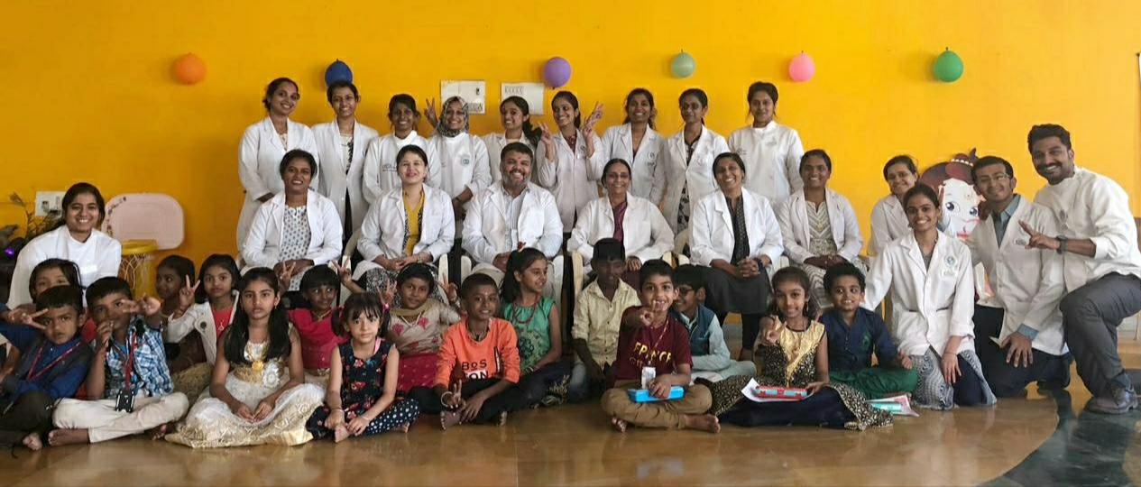
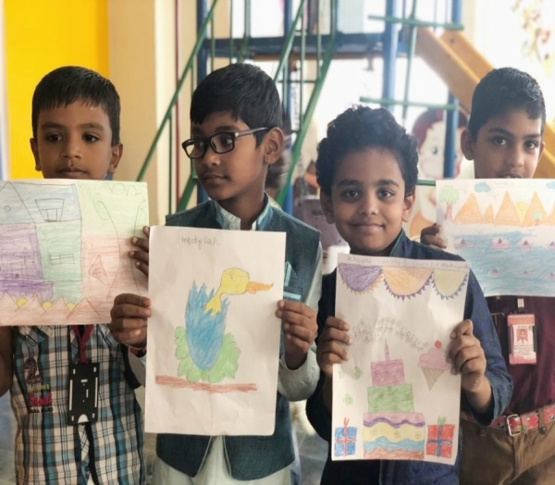
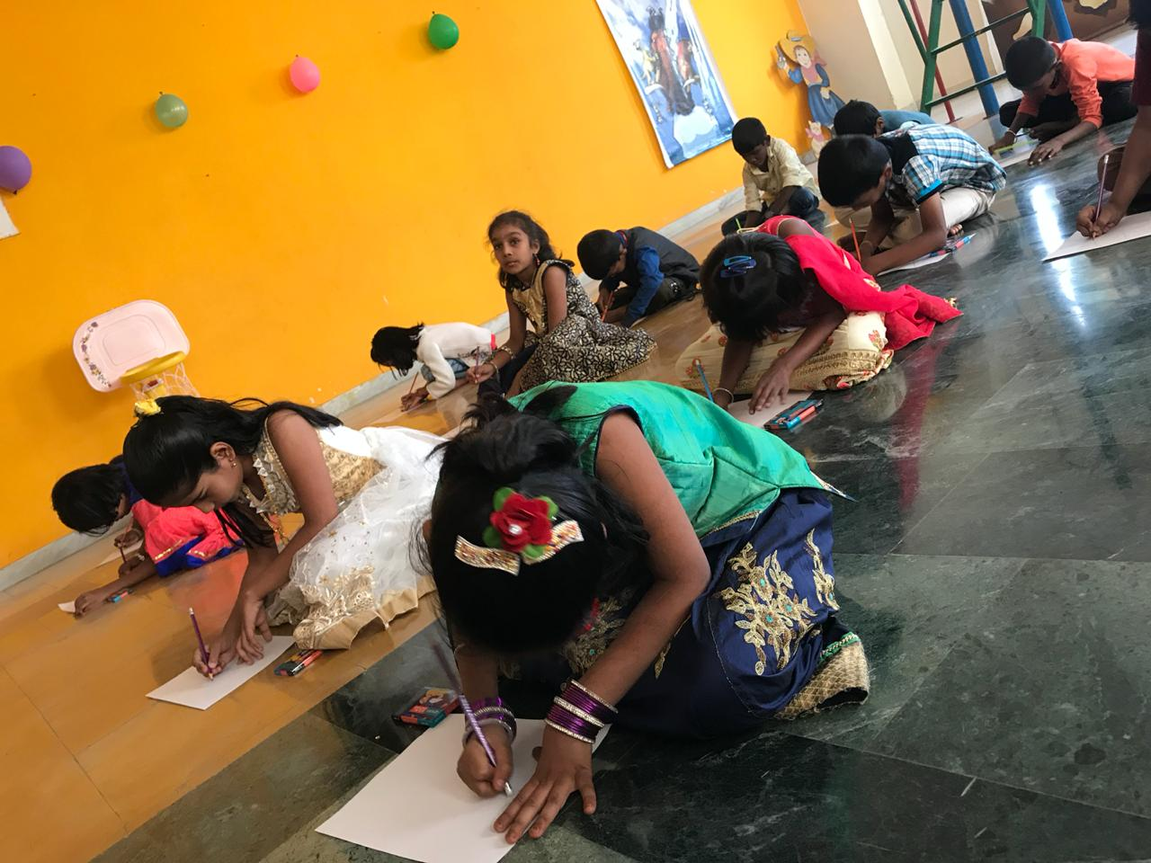
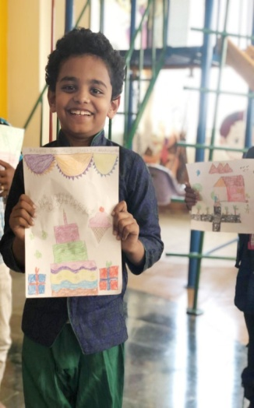
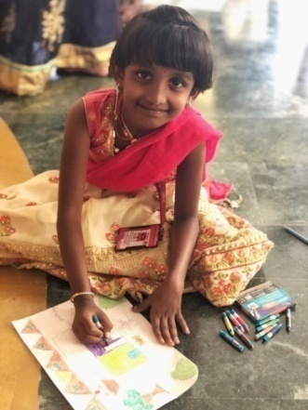
CHILDREN’S DAY CELEBRATION ON 14TH NOVEMBER 2018 IN PEDIATRIC DENTISTRY

Slide 9
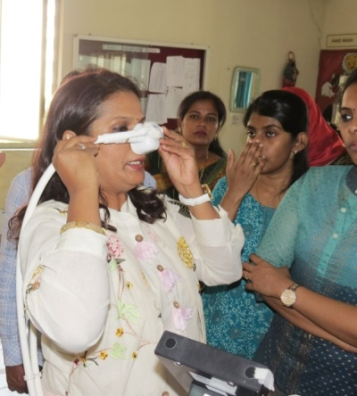
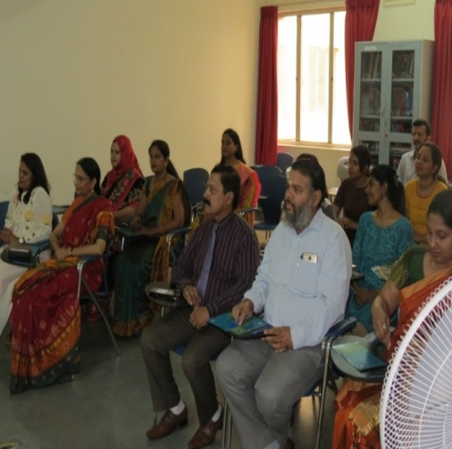
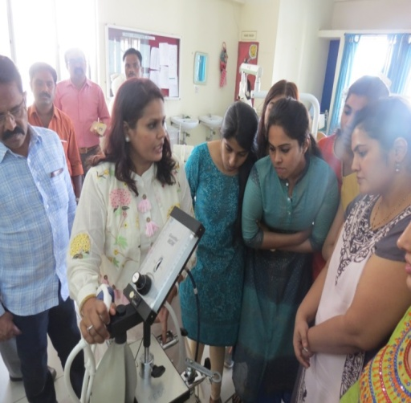
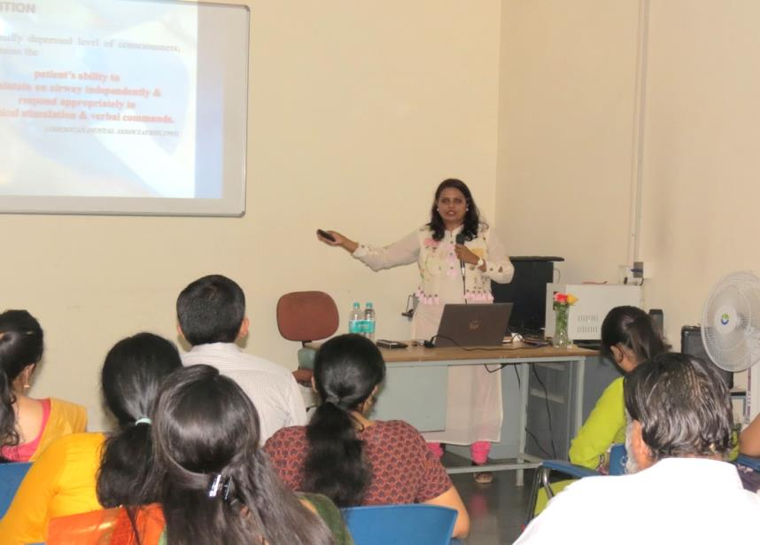
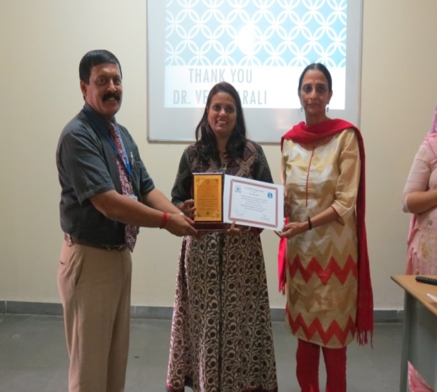
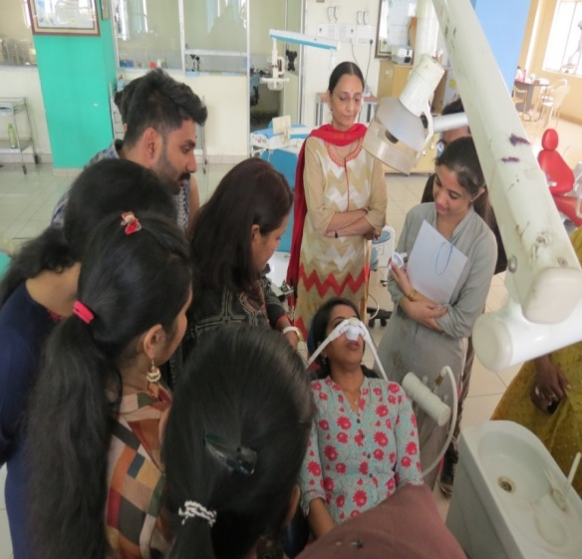
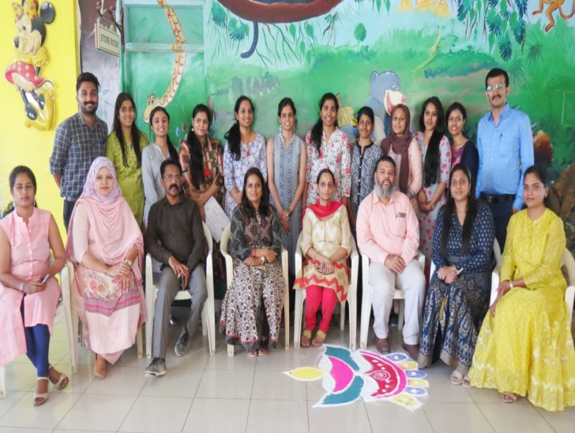
A COURSE ON
INHALATION SEDATION IN PEDIATRIC DENTISTRY
on 15&16 APRIL 2019
Guest speaker- Dr Veena Arali

Slide 10
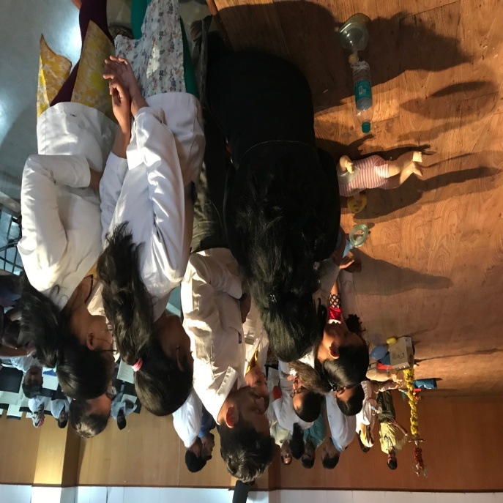
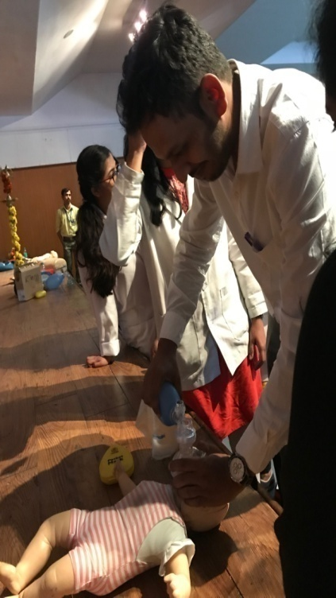
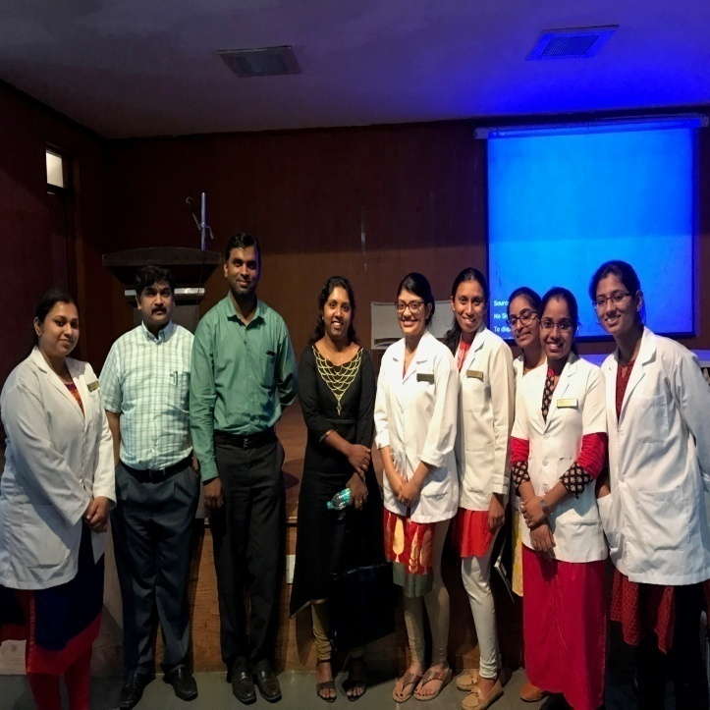
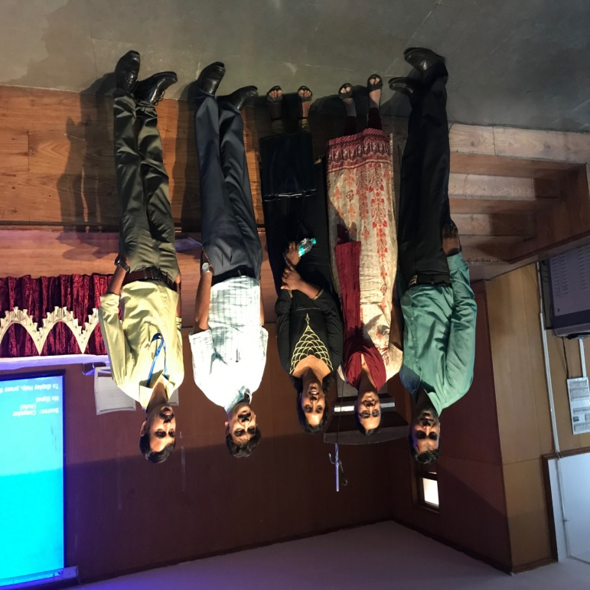
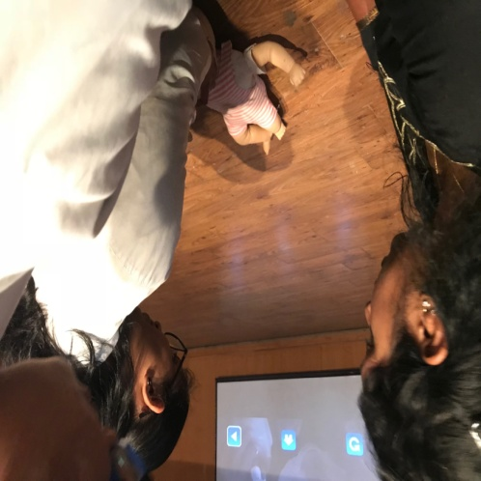
BASIC LIFE SUPPORT COURSE
Organized by Department of Oral and Maxillofacial Surgery
in association with
NARAYANA HRUDAYALAYA HOSPITALS on 01:02:2018

Slide 11
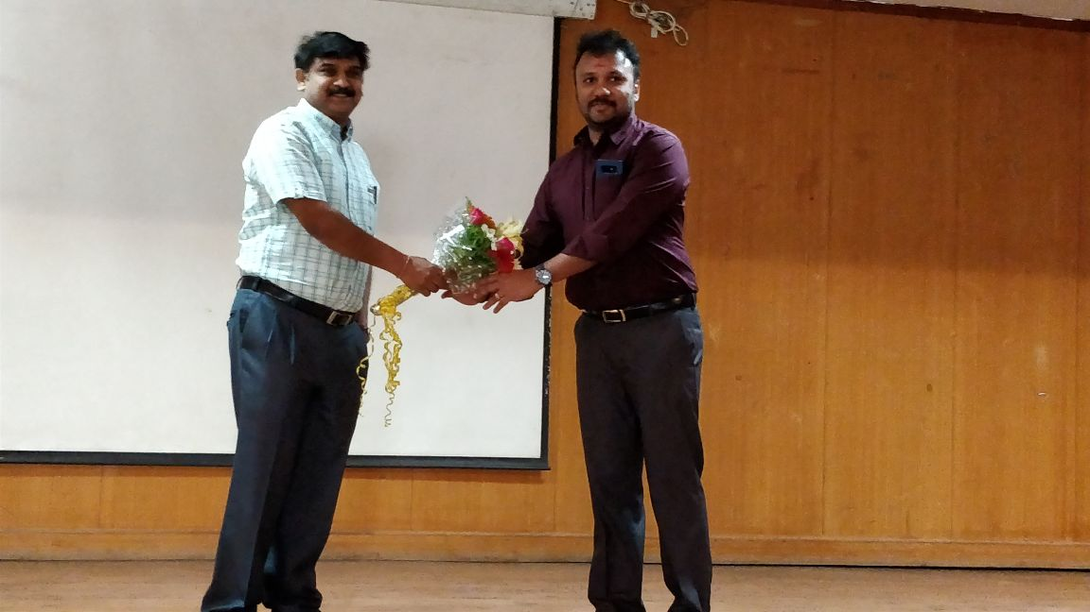
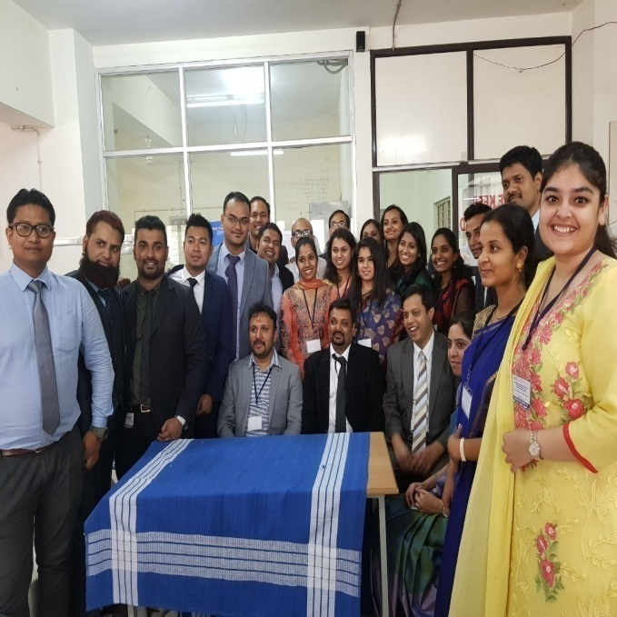
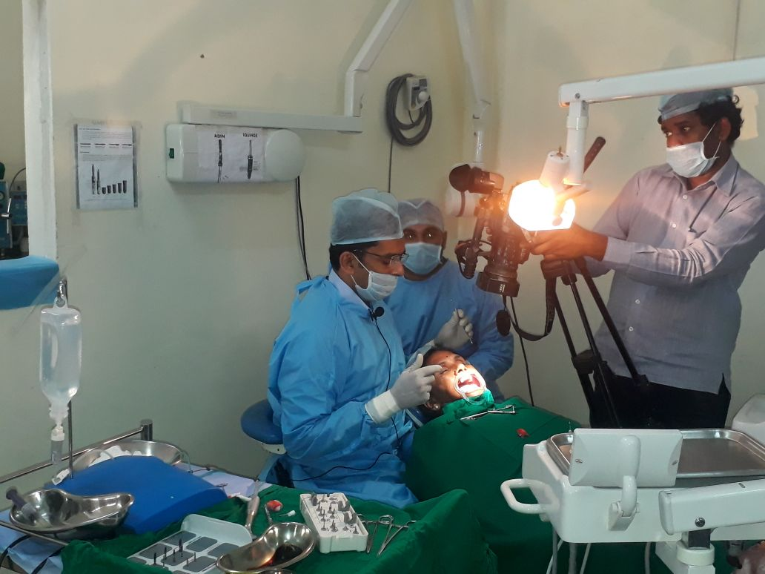
Let’s simplify Oral Implantology
Learning by doing- Lectures, Live surgeries and Hands on Course on 15th, 16th March 2018.
Speakers:
Dr Sony Jacob Mevada, Dr Harish Kumar A, Dr Varunraj L Kamath, Dr Malathi Dayalan,
Dr Savitha.

Slide 12
The Oxford Dental College Department of Public Health Dentistry Programmes conducted report for the academic year 2018 - 2019

Slide 13
Report of the 7 programmes organized by Dept of Public Health Dentistry in The Oxford Dental College, Bangalore.
1. Blood donation camp.
2. Dental out-reach programme. (5-days camp)
3. Hepatitis B vaccination programme.
4. Environmental awareness programme.
5. Independence day celebration.
6. Republic day celebration.
7. Fire drill programme

Slide 14
Programme 1: Blood donation camp
The Oxford Dental College in collaboration with Millennium Blood bank, Yeshwanthpur organized a blood donation camp in The Oxford Dental College on 23rd January 2018. Students from dental, engineering, pharmacy college and physiotherapy college participated in the programme.
We had around 115 registrations out of which 70 pouches of blood were collected. The donors were given a certificate and refreshments after the donation of blood. The blood that was collected was donated to Millennium Blood Bank.

Slide 15
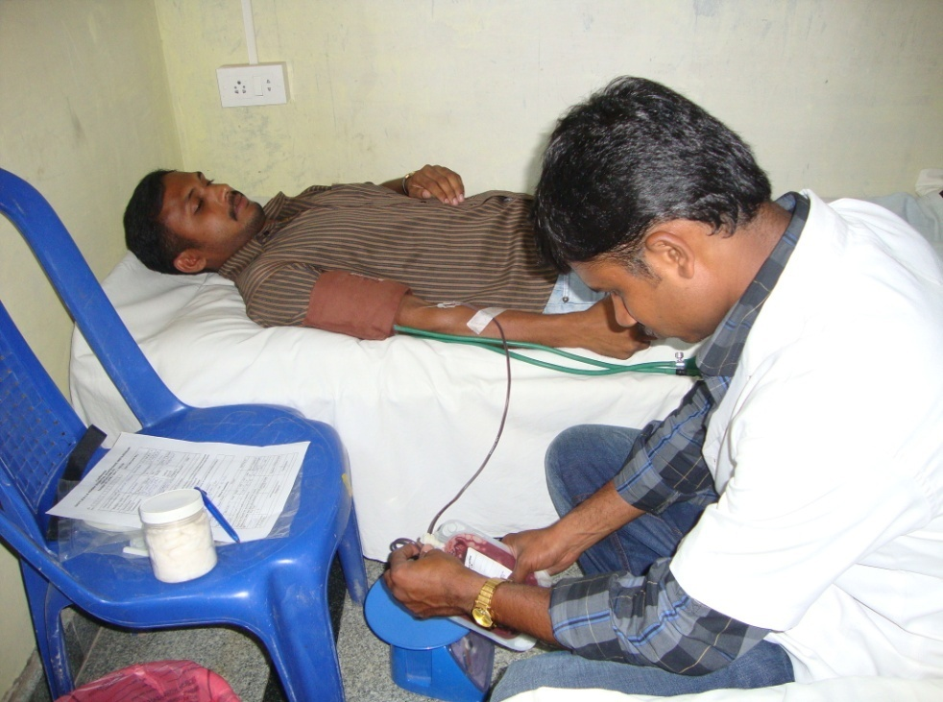

Slide 16
Programme 2: Special Camp. (5 days camp)
Free dental screening and treatment camp was organised by the Department of Public Health Dentistry, The Oxford Dental College in coordination with NSS from 5/8/2018 – 10/8/2018 in Huskur village, Bangalore Rural.
The preparation for the 5 days camp was done before hand. Pamphlets were printed and distributed among the villagers before hand and the post graduate students interacted with the local residents of the Huskur village and encouraged them to participate in the camp.

Slide 17
The camp was initiated by a health talk followed by 20 minutes skit by post graduate students.
The main purpose of the skit was to spread awareness about basic sanitation and cleanliness, brushing habits, water safety and food safety.
It was received well by the public.
The patient turnout was enormous with approximately 150 out patients per day. A total of 746 patients were screened for oral diseases and 315 patients were treated.

Slide 18
The following treatments were done:
Oral prophylaxis: 210
Restorations: 180
Extractions: 70
ART: 47
It was a successful event and we wish to achieve more success in our future endeavours.

Slide 21
Programme 3: Hepatitis B vaccination programme
The Department of Public Health Dentistry in Collaboration with NSS, Infection control committee of the college and HEALTHWAYZ insurance company, organized a vaccination programme for
All the teaching staff
Non-teaching staff
Post graduate and under graduate students

Slide 22
The programme started with a Health talk by Mrs. Sunitha, Head of the Corporate affairs HEALTHWAYZ followed by vaccination for 305 individuals, out of which, 208 individuals took first dose of vaccination which further continued with 2 more doses of vaccination after one month and after 6 months and 97 individuals took booster dose.

Slide 23
Programme 4: Environmental awareness programme
The Department of Public Health Dentistry organized environmental awareness programme at
Chinthanamadiwala village in Huskur Taluk between 9/7/2018 – 27/7/2018,
In order to create awareness among village people regarding
segregation of waste
to reduce the use of plastic
to keep the surrounding clean.

Slide 24
In this direction we motivated them through a street play acted by post graduate students which delivered messages such as
Keep our surroundings clean
Separate dry and wet garbage
Reduce using plastic
Use cloth or paper bags instead of plastic bags. Around 200 villagers were made aware to take care and preserve our environment through this programme.

Slide 28
Programme 5: Independence day celebration
The Department of Public Health Dentistry in collaboration with NSS organized Independence day celebration for all the teaching and non teaching staff, post graduate and under graduate students of The Oxford Dental College on 15/08/2018.

Slide 29
The programme commenced at 8:00 AM in the college premises.
The programme started with a patriotic song performed by interns.
Dean and Director of The Oxford Dental College hoisted the National flag, the students saluted the National flag and pledged to up hold the honour and integrity.
The Cultural Event (Dance Performance) was organized by interns of the college and programme was concluded with a vote of thanks given by Dean and Director.

Slide 31
Programme 5: Republic day celebration
The Department of Public Health Dentistry organized a 70th Republic day celebration for all the teaching and non teaching staff, post graduate and under graduate students of The Oxford Dental College on 26/01/2019.

Slide 32
The celebration commenced at 8:00 AM with warm welcome and invocation song. The Dean and Director of The Oxford Dental College hoisted the National flag. The flag hoisting ceremony was followed by national anthem, the students saluted the National flag and pledged to up hold the honour and integrity.
The college campus turned reverberated with the rhythmic vocal performances presented by the students. The celebration was concluded with the heartfelt vote of thanks given by the Dean and Director

Slide 34
7. Fire drill programme.
The Department of Fire Safety services, Karnataka state organized a live demonstration regarding the safety measures to be observed incase of fire accidents on 4th of June 2019.
A team from the department carried out fire demonstration and drill and created awareness to deal in any case of emergency.

Slide 35
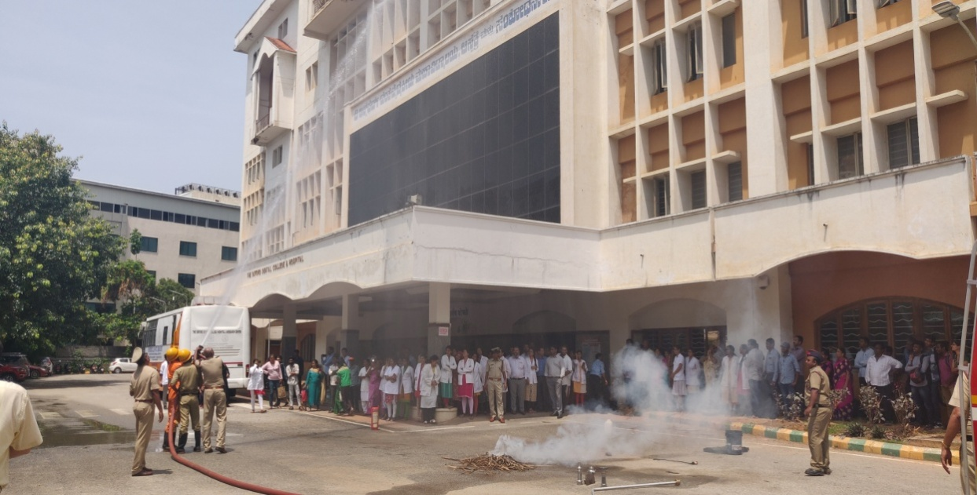

Slide 36
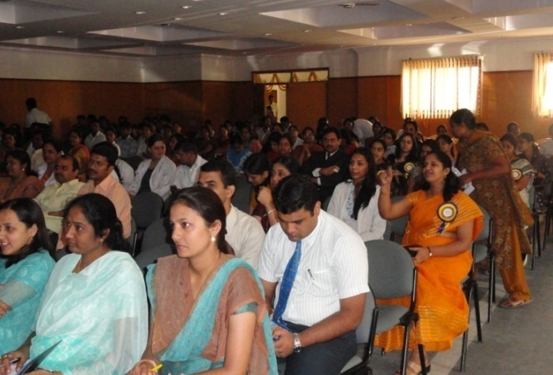
‘’Unveiling the art of scientific publication’’
Speakers: Dr Akthar Hussain who delevired lecture on ‘Insight on Dental and Clinical photography.
Dr. C Ramesh- delivered a lecture on ‘Biostatistics’
Dr Suhas- delivered lecture on ‘Getting published’

Slide 37
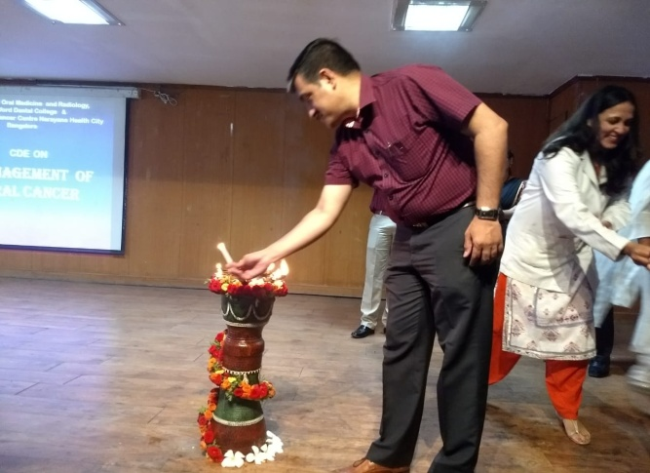
‘Management of Oral Cancer’
Speakers were from :Mazumdar Shaw Cancer Centre
and Narayana Health Centre.

Slide 38
‘Oral Cancer Diagnosis and Management’
Speakers were from: Kidwai Memorial Institute of Oncology
and Sri Sankar Cancer Hospital

Slide 39
OXFORD DENTIUM IMPLANT COURSE – MODULE 1 –Lecture and Hands on Workshop Organized by Department of Periodontics in association with Dentium Implants on 15.11.2018 n 16.11.2018. Speaker: Dr. Tarun Kumar A.B.

Slide 40
OXFORD DENTIUM IMPLANT COURSE – MODULE 2 –LIVE SURGERY WORKSHOP Organized by Department of Periodontics in association with Dentium Implants
on 07.03.2019 n 08.03.2019. Speaker: Dr. Tarun Kumar A.B.

Slide 41
OXFORD DENTIUM IMPLANT COURSE – MODULE 3 –IMPLANT PROSTHODONTICS AND
IMPRESSION TAKING Organized by Department of Periodontics in association with Dentium Implants
on 07.03.2019 n 08.03.2019. Speaker: Dr. Ramesh Choudhary, Dr. Jhang Hyun Park

Slide 42
CDE PROGRAM OF MASTER CLASS SERIES Organized by Department of Periodontics on 06.12.2018 Speakers: Dr. A.R. PRADEEP,
Dr. ANIRBAN CHATTERJEE
Dr. AJAZ PASHA

Slide 43
ORAL B TALK ON “ IMPORTANCE OF MODERN DAY ORAL HYGIENE AIDS-INTERDISCIPLINARY APPROACH ”- ORGANIZED BY DEPARTMENT OF PERIODONTICS ON 20.03.2019 SPEAKER: DR. SHOBHA K.S.

Slide 44
Professional Enrichment Program talk:
Influence of periodontal disease on systemic health
Modern day approaches in oral hygiene
On 11.03.2019 SPEAKERS: DR. VINAYAK R.,
Dr. GURUPRASAD C.N.

Slide 45
Professional Enrichment Program talk:
Cortical Implantology: Simple solution to everyday dental implant practice.
Speaker: Dr VEERENDRA KUMAR
On 01/03/2018

Slide 46
INTEGRATE 2018, AN ADVANCED
IMPLANT PROGRAM
Two day program focussing on advanced
aspects of Implantology
SPEAKERS:
Dr. NARAYAN T V
Dr. JEEVAN AIYAPPA
On
26/07/18-27/07/18

Slide 47
LASER Dentistry Preconference Workshop
Part of 3rd International Digital Dental Conference
SPEAKERS:
Dr.VIDYAA HARI IYER
Dr.MAHENDRANADH
REDDY
ON
03/8/18

Slide 48
SiRONA LASERS by DR.SWATI GOGAWAT on 28.02.2017

Slide 49
NEW RESTORATIVE MATERIAL – ALTERNATIVE TO AMALGAM by DR.LEKHA.S on 17.05.2017

Slide 50
AMOXYCILLIN CLAVUNATE IN DENTAL INFECTIONS by DR. JAYKUMAR on 15.06.2017

Slide 51
CDE on Professional Negligence And Legal Aspects In Medical Practice was conducted by our Department on 13th jan by Dr. Prahlad

Slide 52
CDE - Lecture cum hands on course in collaboration with Mani Medical India was conducted by our Department on 24th jan on Management of Endodontic complication on course by Dr. Vinod

Slide 53
Colgate company conducted a product introduction program to our post graduates on 12/2/18

Slide 54
Predictable endodontics with new Ni-Ti files by Dr. Jayshree Hegde on 28-11-2018

